Slide 1

Intro to Karate

Slide 2
What is it?
Karate is an open-source tool to combine API test-automation, mocks, performance testing & UI automation into a single, unified framework.
It’s based on Cucumber-JVM, with JSON & XML assertions and step definitions built-in – no extra Java code is needed to get your feature files to “do something.”

Slide 3
Core Features & Capabilities
Step definitions built-in – no “glue” (i.e. Java code) needed
Data-driven testing (i.e. “Scenario Outline” + “Examples”)
Parallel test execution
HTML reports – including in-line HTTP requests & responses
Seamless integration into CI / CD pipelines
Elegant domain-specific language syntax with native support of JSON & XML
Native support for reading YAML & CSV files
JUnit 4/5 support
Fully featured debugger
Embedded JavaScript engine (Nashorn)
Ref: https://github.com/intuit/karate#features

Slide 4
Additional Features & Capabilities
Test Java servlets without containers using Karate Mock Servlet
Create API test doubles to facilitate consumer-driven contract testing using Karate Netty
Performance test an API using Karate Gatling

Slide 5
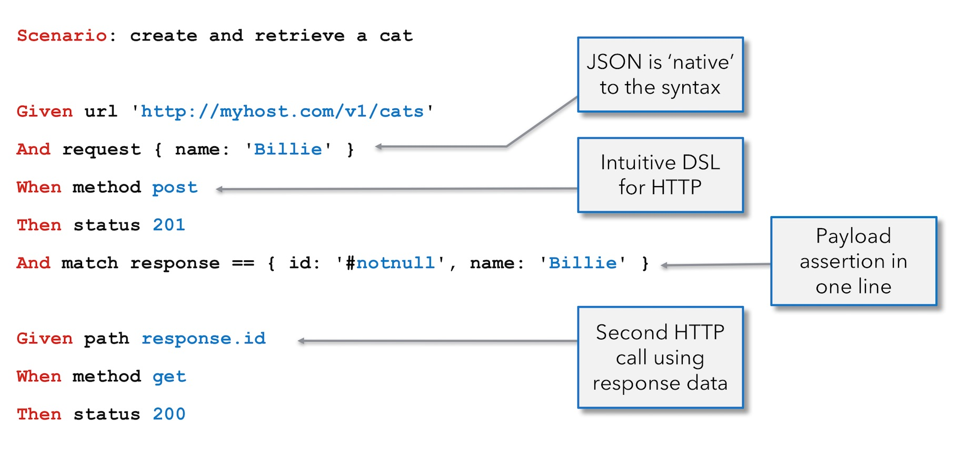

Slide 6
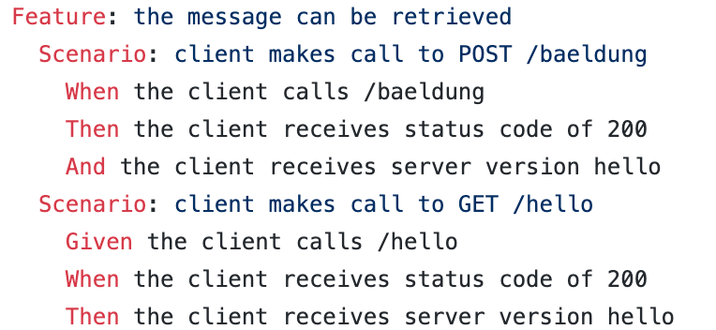
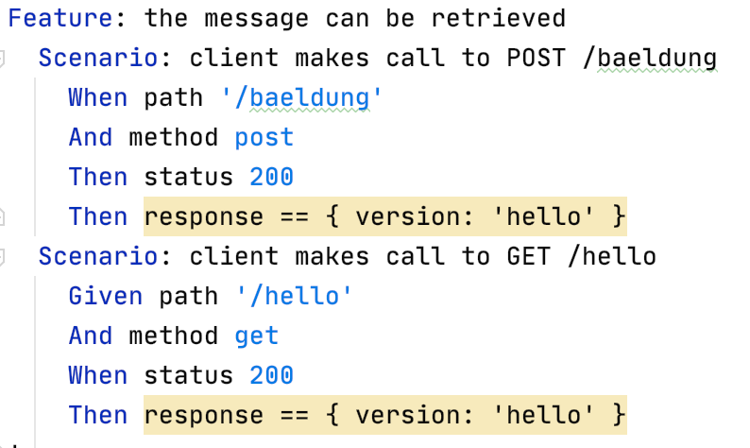
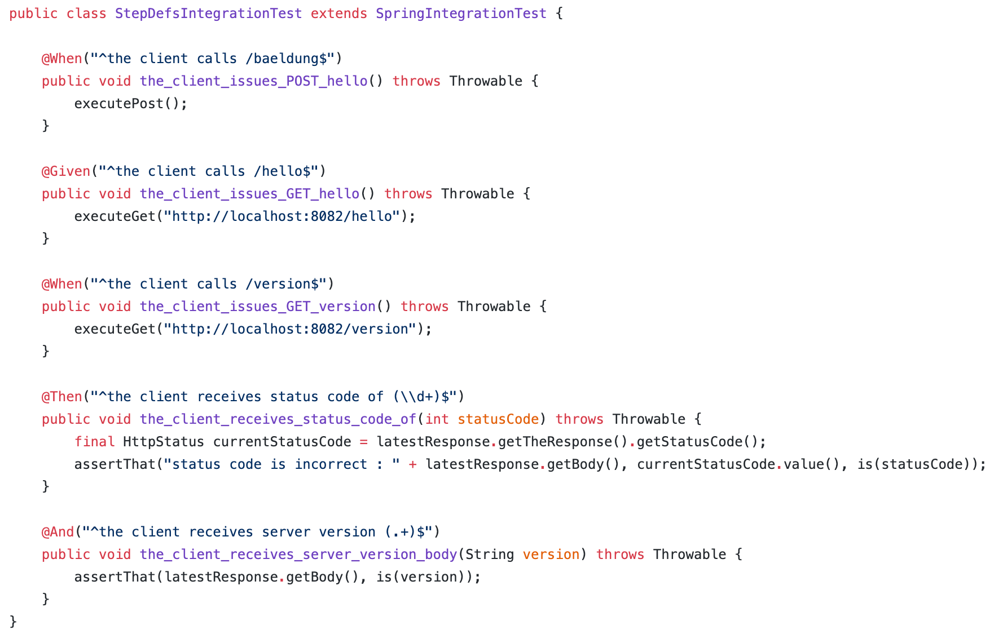
Feature File
Cucumber vs. Karate
Karate
Step Definitions, a.k.a. “Glue”
Notes:
https://github.com/eugenp/tutorials/blob/master/spring-cucumber/src/test/resources/baelung.feature
https://github.com/eugenp/tutorials/blob/master/spring-cucumber/src/test/java/com/baeldung/StepDefsIntegrationTest.java

Slide 7
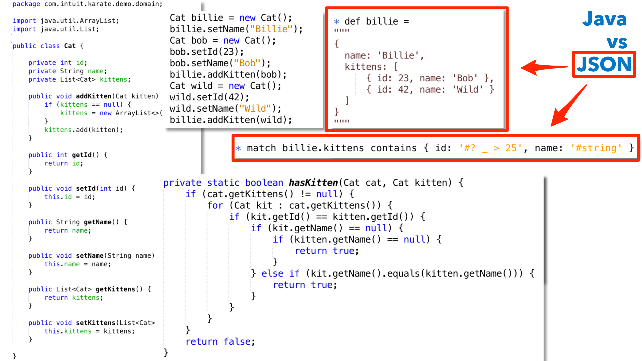

Slide 8
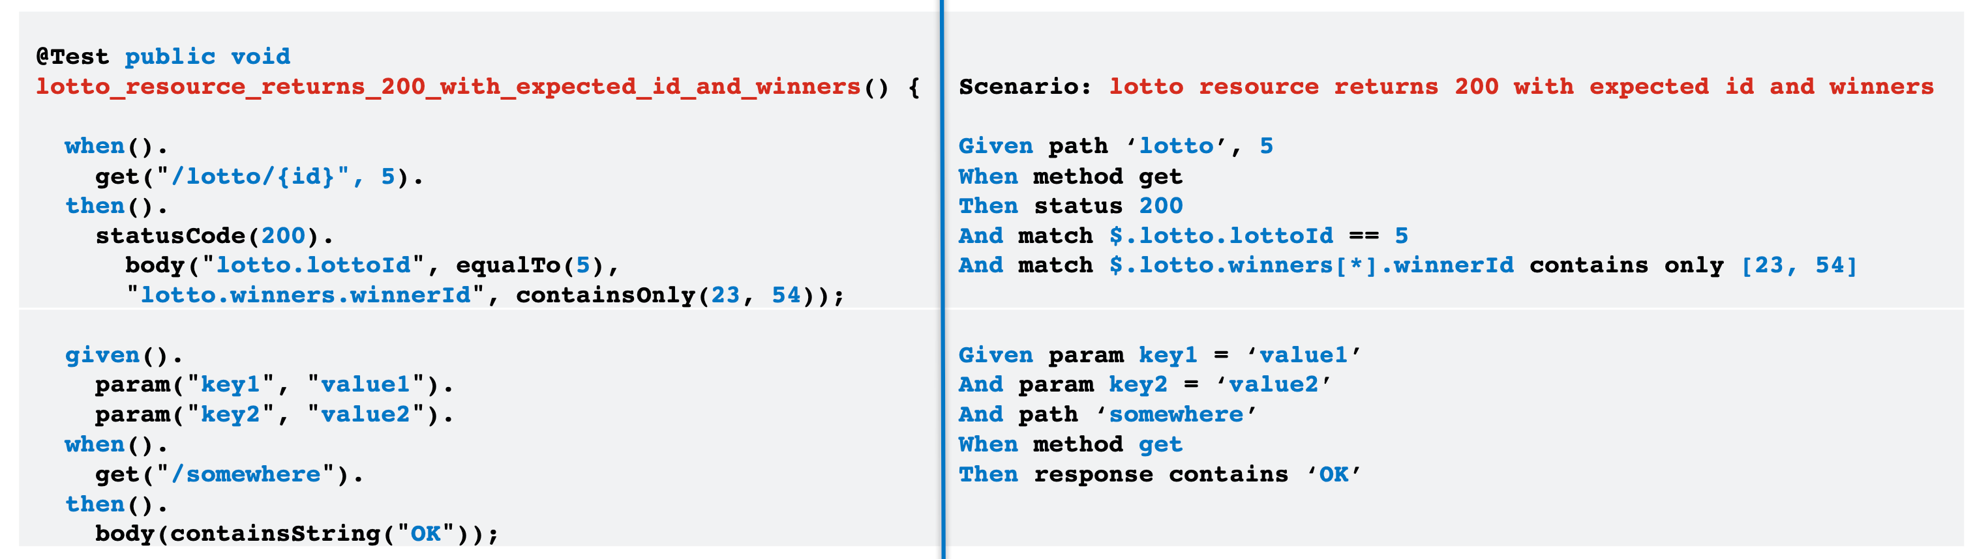
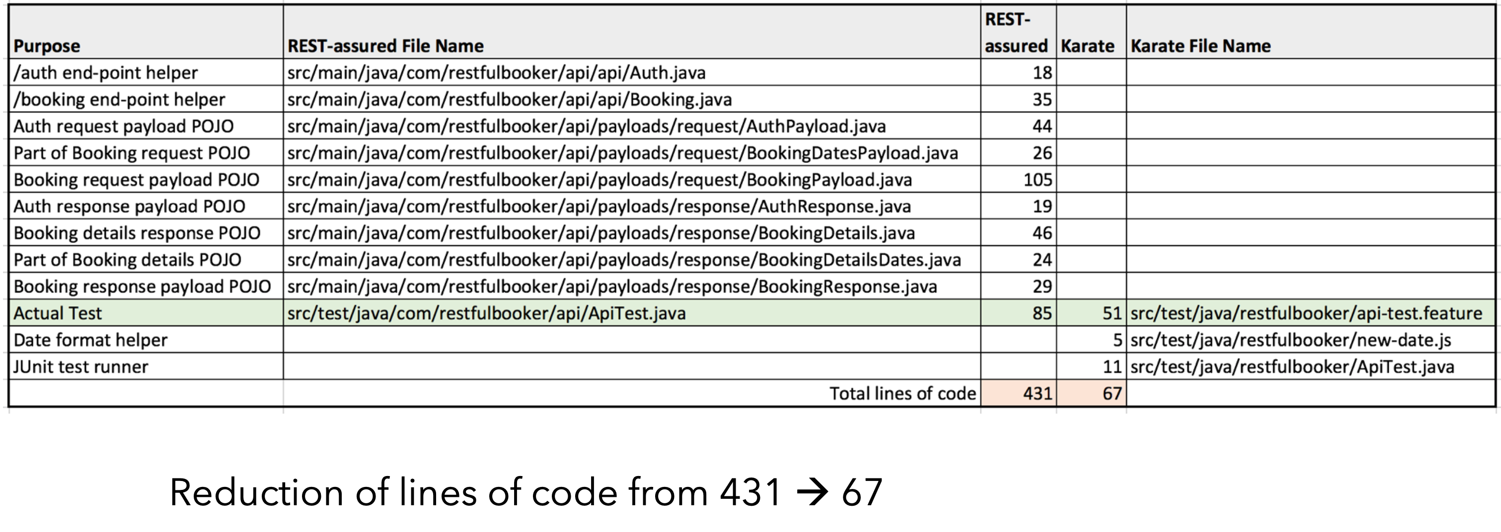
Comparison with REST Assured
Notes:
Link: https://github.com/mwinteringham/api-framework/pull/3

Slide 9
Getting Started
To get started with a new project,
Click New Project on the IntelliJ home screen, then choose Maven as a project type, along with a Project SDK of Java 11
Click the Select from archetype checkbox and then click the Add Archetype button, in fill in the following details:
GroupId = com.intuit.karate
ArtifactId = karate-archetype
Version = 1.0.1
On the next screen, give your project a name & location and specify your Artifact Coordinates
On the next screen, click Finish
Note: If you’re using IntelliJ Community Edition, you’ll need to install the Cucumber for Java plugin (you’ll be prompted to install the Gherkin plugin, as well). If you’re using IntelliJ IDEA, these plugins are already installed.

Slide 10
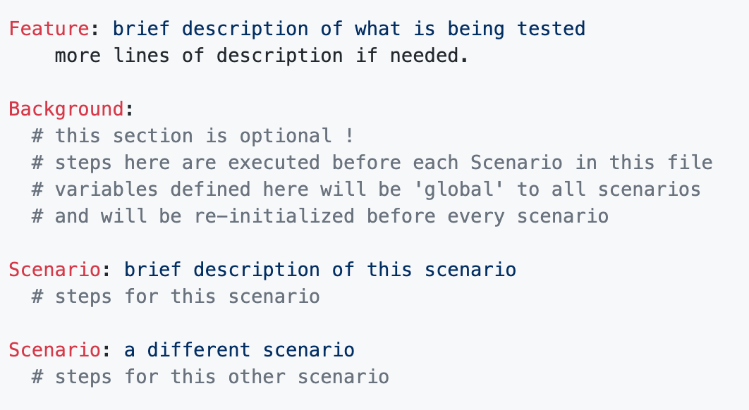
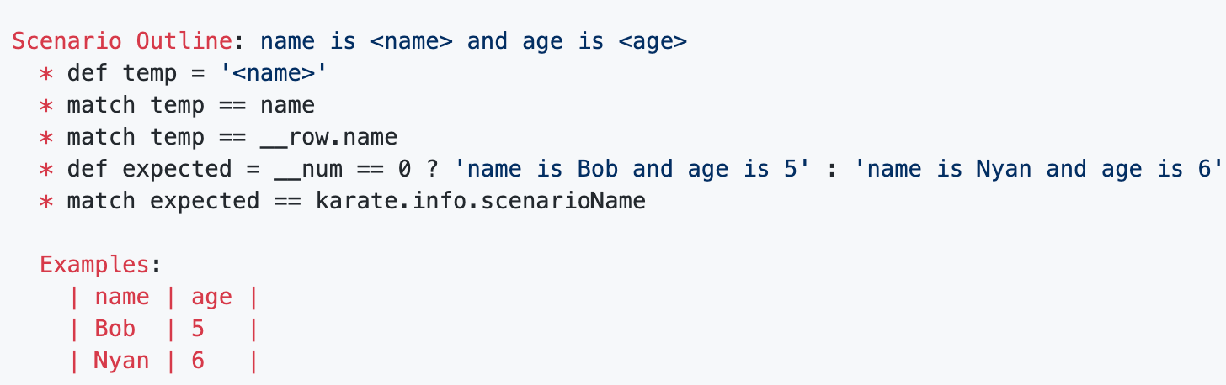
Creating a Feature File
Karate scripts are written in Gherkin format, and consist of:
A Feature section,
A Background section, and
One or more Scenario sections, or
For data-driven tests, a Scenario Outline along with Examples
Also, like with Cucumber feature files, each step in a Karate feature file begins with Given, When or Then. You can also substitute ‘*’ for these three keywords.

Slide 11
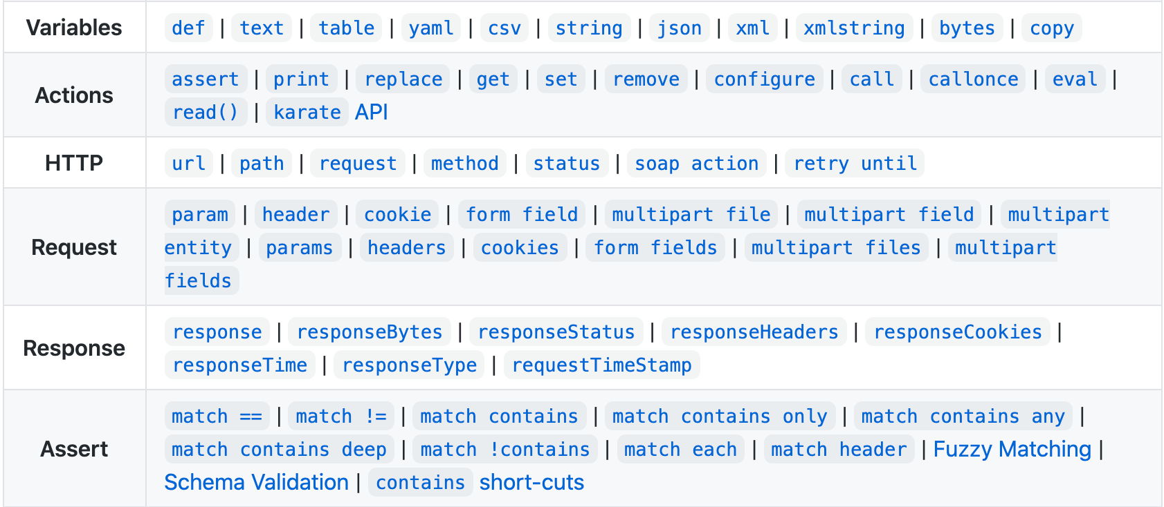
Core Variables, Actions & Keywords

Slide 12
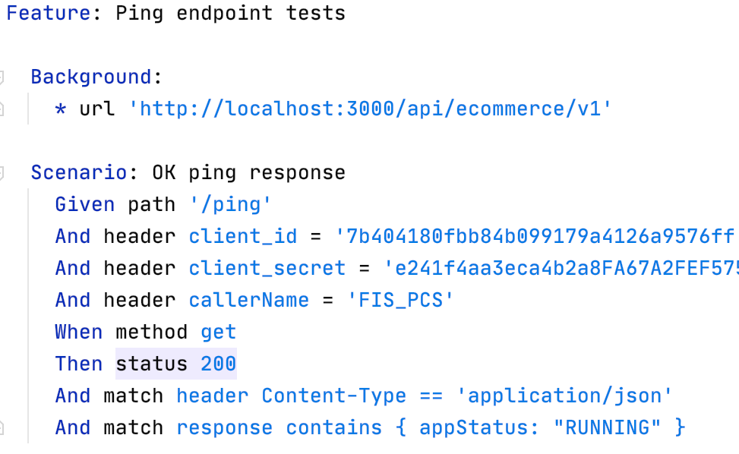
Sample GET Request
Define our Feature
Specify our URL, which will apply to all Scenarios underneath
Set our path, headers & method (GET)
Define the status we’re expecting to receive along with any header & response body attributes

Slide 13
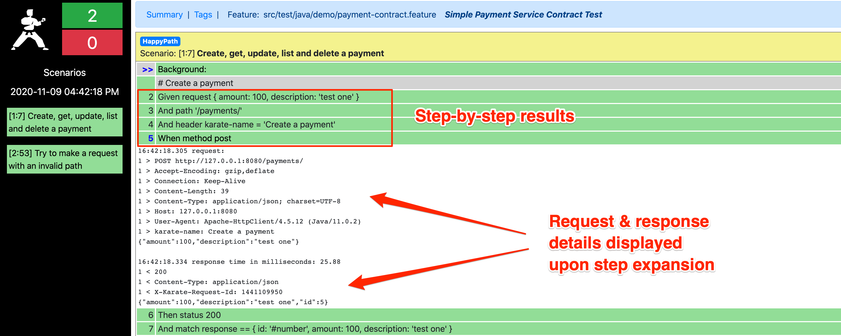
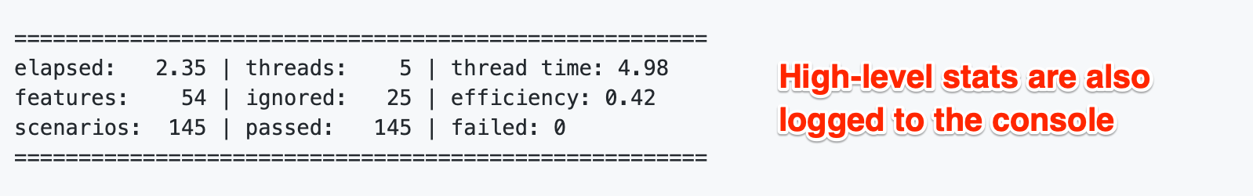
Reports

Slide 14
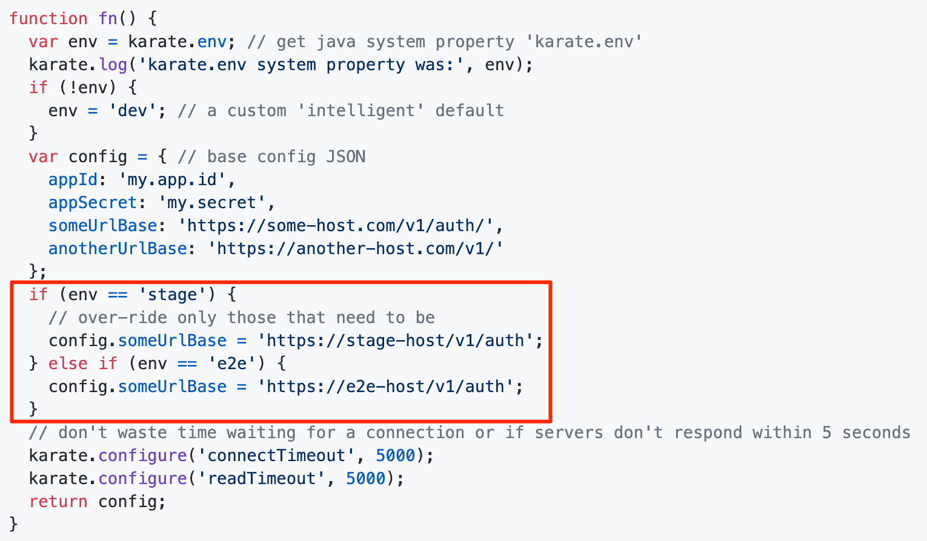
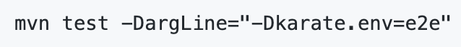
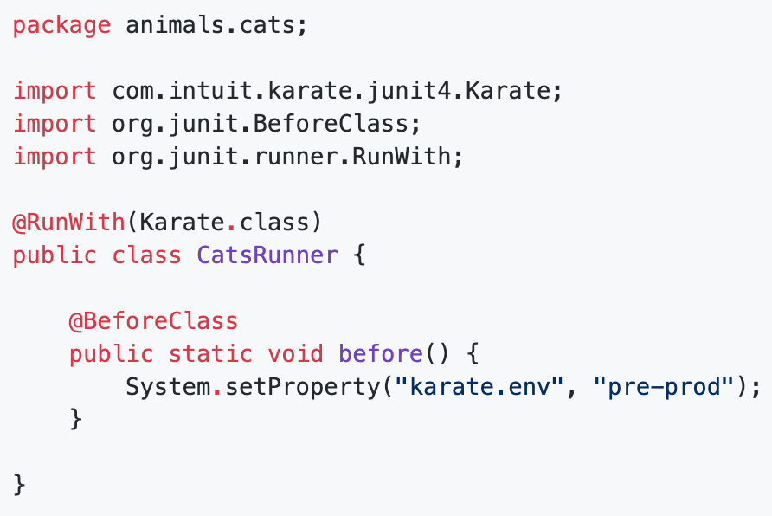
Switching Environments
Environment variables are configured in the karate-config.js file:
You can specify which environment to use when running Maven from the command line:
…or by hard-coding it in a runner file:

Slide 15
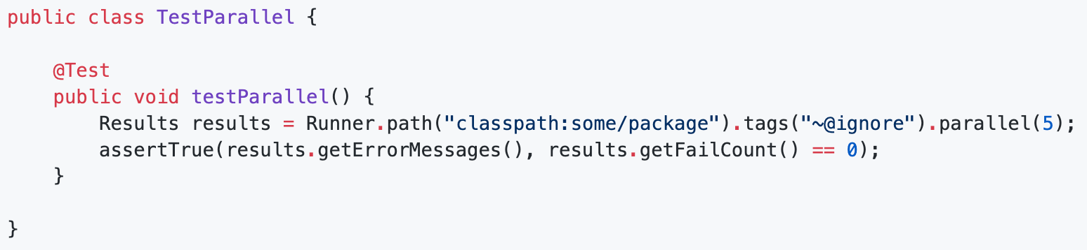
Parallel Test Execution
Karate can run tests in parallel with a little help from JUnit (4 or 5) and a simple test runner
Runner.path() is used to define which packages (or specific files within a package) you want to execute in parallel
The tags() API is used to include/exclude certain Scenarios (e.g. “@IncludeThisTest” or “~@SkipThisTest” or “@parallel=false” to execute, but not in parallel)
The last method called, parallel(), is where you pass the number of parallel threads needed

Slide 16
Running Tests from a Docker Container
Assumptions:
Docker Desktop is installed on your machine
Your Karate files are located in your project’s ./src/test/java folder
Steps:
1. Create a Dockerfile in your project folder using a Maven docker image with Java (https://hub.docker.com/_/maven):
FROM maven:3.6.3-jdk-11
WORKDIR /usr/src/app
COPY pom.xml /usr/src/app
COPY ./src/test/java /usr/src/app/src/test/java
2. Build a docker image (in this example, “karatetest”) and run the container (“karatetest”) from the terminal:
$ docker build -t karatetest .
$ docker run -it karatetest
3. Create a Docker Compose file (e.g. docker-compose.yml) to configure the build in a better way, to map a “target” folder in the container to your host machine (so you can view reports and details of each test run) and also map your host machine’s cache to the container as a reference for Maven dependencies:
version: "3.8"
services:
karate-tests:
image: karate-tests
build:
context: .
dockerfile: ./Dockerfile
volumes:
- ./target:/usr/src/app/target
- ~/.m2:/root/.m2
command: mvn test
4. Run Docker Compose:
$ docker-compose up --build
5. Finally, when you’re done, shut down the container:
$ docker-compose down

Slide 17
API Test Doubles with Karate-Netty

Slide 18
Core Features & Capabilities
Use a simple feature file to create both hard-coded & stateful mocks
Start and stop mock servers in milliseconds
Easy HTTP request matching by path, method, headers, body etc.
Simulate slow, delayed, error or malformed responses
Built-in CORS support
Ref: https://github.com/intuit/karate/tree/master/karate-netty

Slide 19
Client-Side vs. Server-Side Feature Files
Background is executed upon start-up and used to read files and setup common functions & ‘global’ state, e.g.:
Background:
* configure cors = true
* configure responseHeaders = { 'Content-Type': 'application/json’ }
Unlike a client-side feature file, Background is NOT executed before each Scenario.
Scenario Outline is NOT supported on the server-side.
Each Scenario is expected to have a JavaScript expression as the content of its description, e.g.:
Scenario: pathMatches('/v1/headers') && methodIs('get')
For an incoming request, Scenario sections are evaluated in order, and if the expression evaluates to ‘true’, the body of the Scenario is evaluated to generate and return a response (so it makes sense to make your last Scenario have an empty description as a failsafe, e.g. “404 Not Found”).

Slide 20
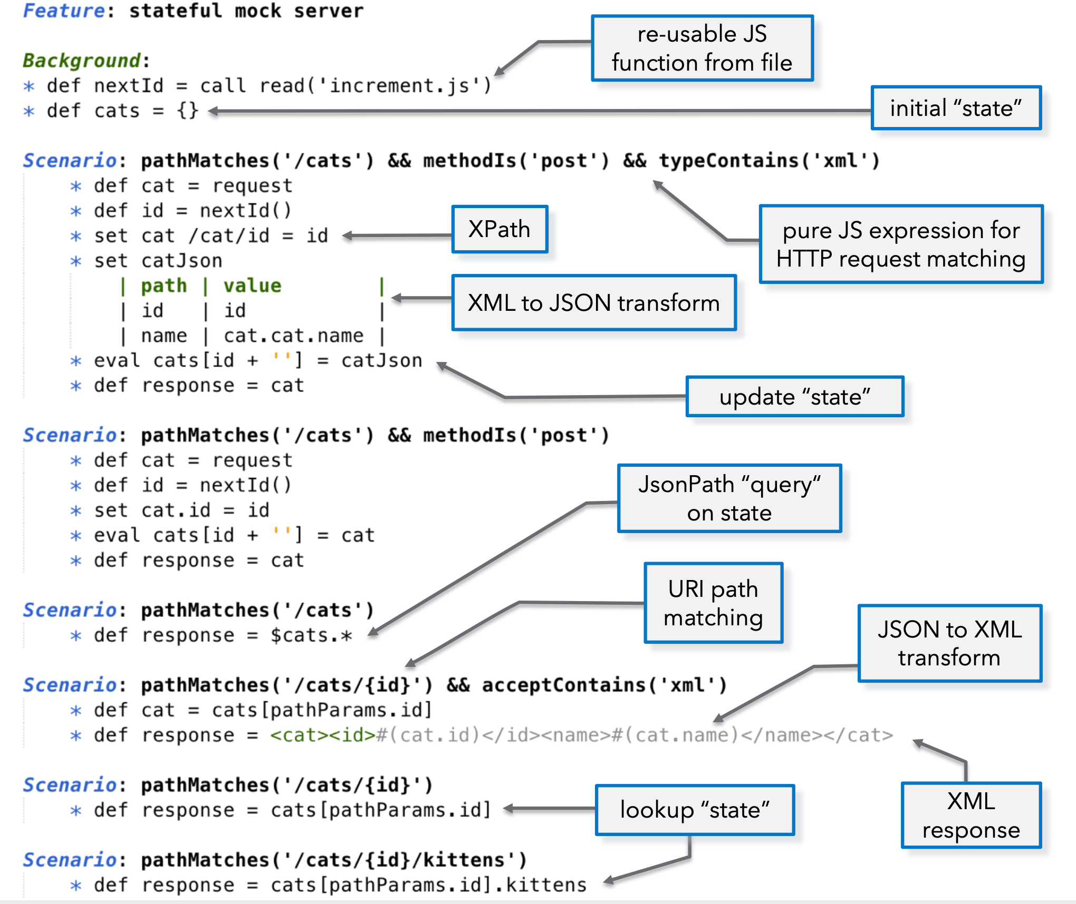

Slide 21
Starting & Stopping a Karate Server
Starting and stopping a Karate server can be done via the Java API which allows you to mix Karate into Java code, JUnit tests & Continuous Integration pipelines.
The com.intuit.karate.netty.FeatureServer class has a static start() method that takes 4 arguments:
Feature file(s)
file: a java.io.File reference to the *.feature file you want to run as a server
files: a List<java.io.File> as above, if you have multiple
port: int value of the port you want to use. 0 means, Karate will dynamically choose a free port
ssl: boolean flag that, if true, starts an HTTPS server and auto-generates a certificate if it doesn't find one
arg: java.util.Map of key-value pairs that can be used to pass custom variables into the *.feature evaluation context - or null if not-applicable
The static start() method returns a FeatureServer object on which you can call a getPort() method to get the port on which the server was started. And a FeatureServer instance has a stop() method that will stop the server.

Slide 22
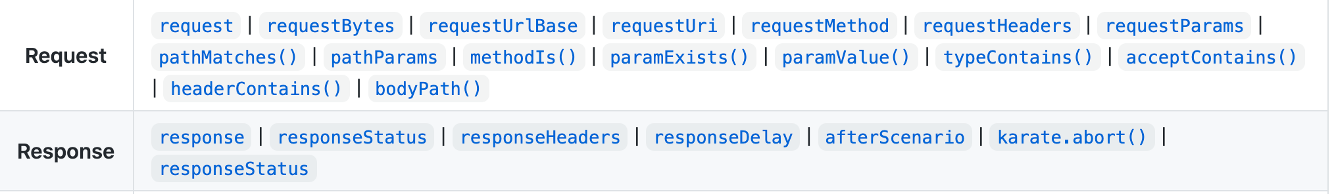
Request Handling & Response Building Commands

Slide 23
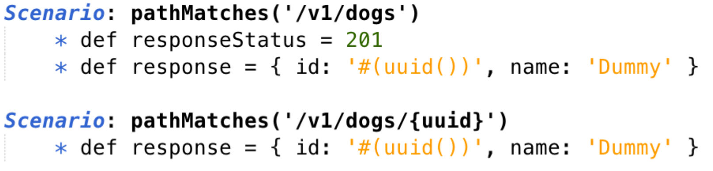
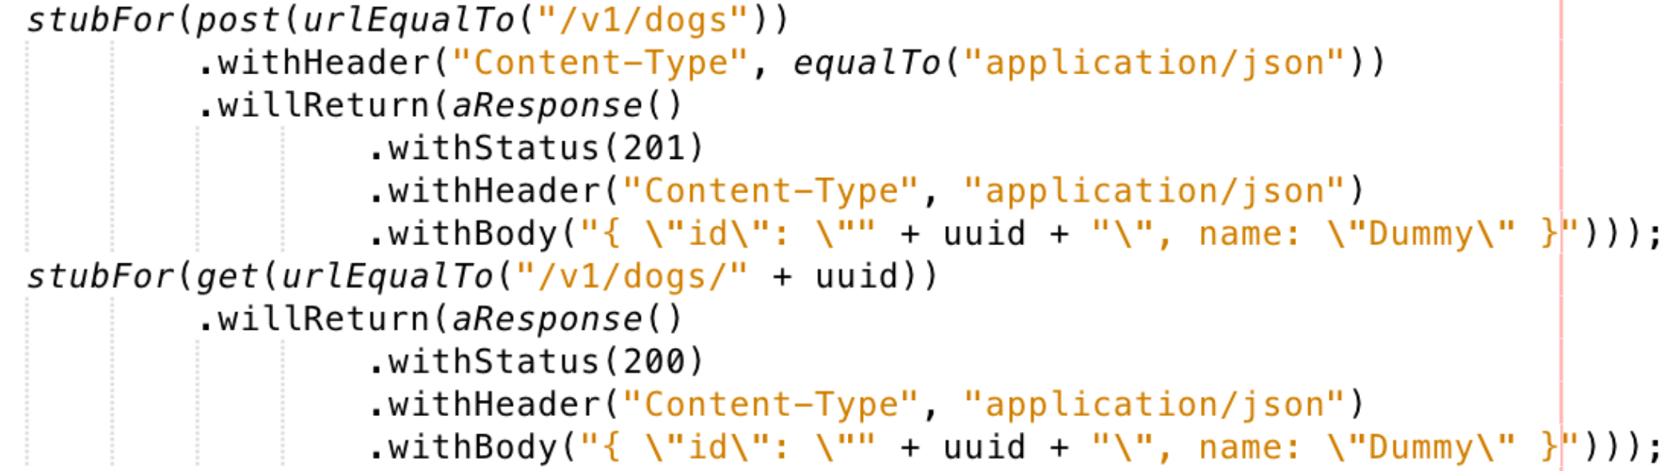
Comparison with WireMock

Slide 24
Performance Testing with Karate

Slide 25
Core Features & Capabilities
Re-purpose Karate tests as performance tests (executed by Gatling)
Leverage Karate’s assertion capabilities to validate server responses under load
Assertion failures appear in Gatling reports along with the line numbers that failed
Option to scale out by distributing a test over multiple hardware nodes or Docker containers
Anything that can be written in Java can be performance tested
Ref: https://github.com/intuit/karate/tree/master/karate-gatling

Slide 26
Assumptions & Prerequisites
Install the Scala plugin for IntelliJ (don’t worry – you’ll only be using Scala to define your load model…Karate does the rest)
If you haven’t created one yet, go ahead and create a feature file – you’ll be re-purposing it as your performance tests
Create a folder under ~/src/test/java called “performance,” and a 2nd folder underneath it called “data”
Copy the feature file(s) you’ll be working with to the new ~/performance folder

Slide 27
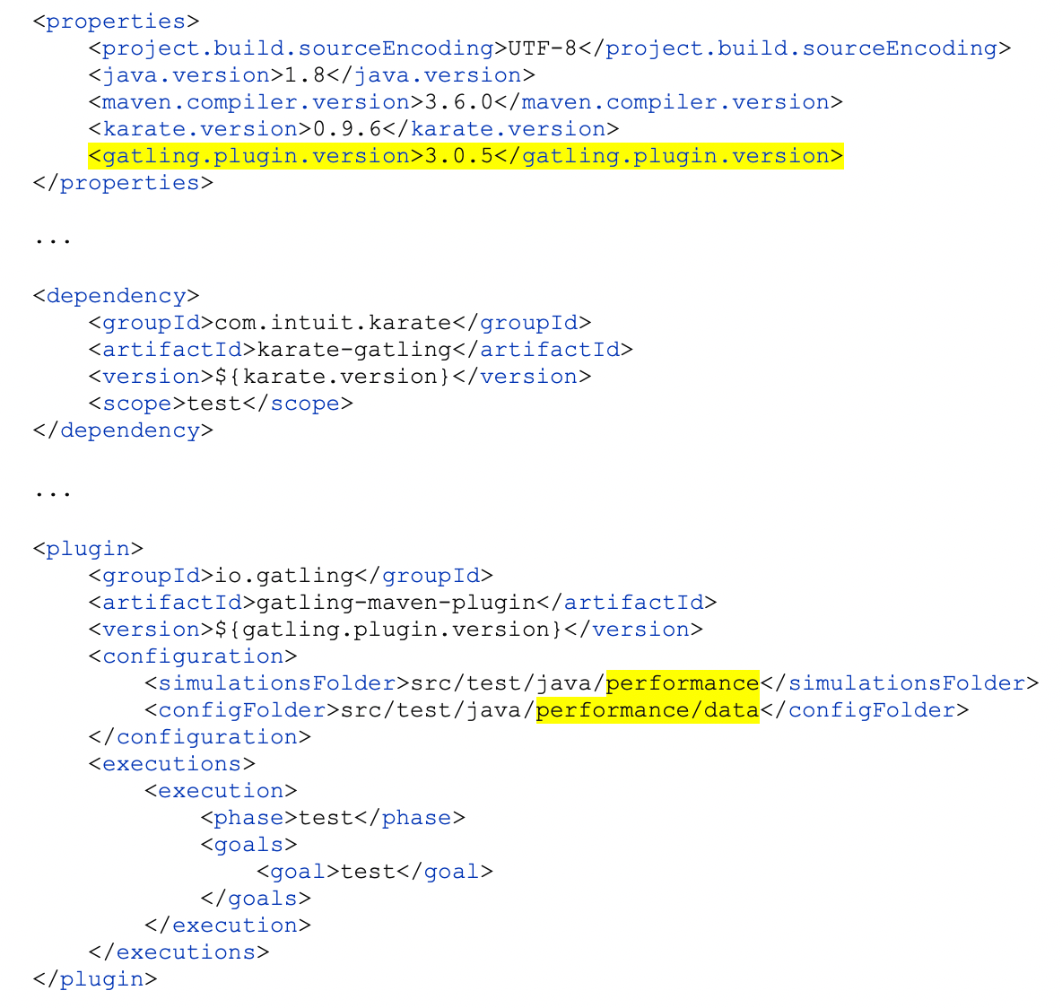
Maven Dependencies
You’ll need to add a “karate-gatling” dependency and “gatling-maven-plugin” to your POM file.
Note that in the <plugin> section it’s assumed you’ll be adding performance tests and their configuration files to the following folders:
~/src/test/java/performance
~/src/test/java/performance/data
…so change these if you decided to house things elsewhere.
Notes:
Copy/paste these to your POM file:
<properties> <project.build.sourceEncoding>UTF-8</project.build.sourceEncoding> <java.version>1.8</java.version> <maven.compiler.version>3.6.0</maven.compiler.version> <karate.version>0.9.6</karate.version> <gatling.plugin.version>3.0.5</gatling.plugin.version> </properties>
...
<dependency> <groupId>com.intuit.karate</groupId> <artifactId>karate-gatling</artifactId> <version>${karate.version}</version> <scope>test</scope> </dependency>
...
<plugin> <groupId>io.gatling</groupId> <artifactId>gatling-maven-plugin</artifactId> <version>${gatling.plugin.version}</version> <configuration> <simulationsFolder>src/test/java/performance</simulationsFolder> <configFolder>src/test/java/performance/data</configFolder> </configuration> <executions> <execution> <phase>test</phase> <goals> <goal>test</goal> </goals> </execution> </executions> </plugin>

Slide 28
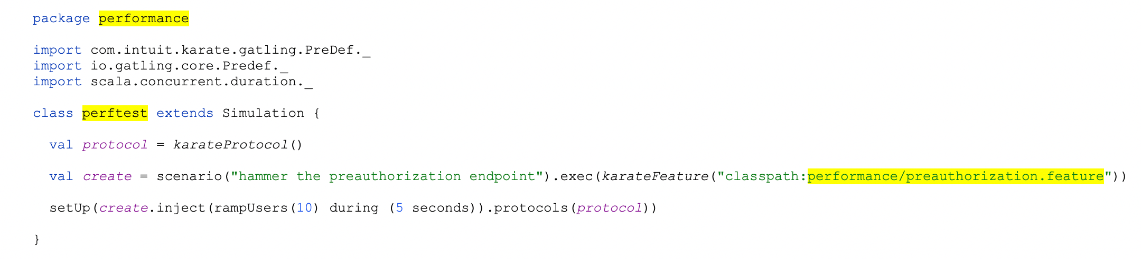
Create a Simulation
In the ~/performance/data folder, create a new file and call it perftest.scala (or whatever you want, really, with a “.scala” extension), then add this to the file:
Note there are a few assumptions here:
· You named the file “perftest.scala”
· Your classpath is “performance”
· Your feature file is named “preauthorization.feature”
And that’s it! You can get fancy with the settings in the Scala file and whatnot, but that’s about all it takes to create a simulation that will hammer away at an endpoint using a feature file.
To run your test, run this from the command line: mvn clean test-compile gatling:test
Notes:
Cut/paste this into your perftest.scala file:
package performance import com.intuit.karate.gatling.PreDef._ import io.gatling.core.Predef._ import scala.concurrent.duration._ class perftest extends Simulation { val protocol = karateProtocol() val create = scenario("hammer the preauthorization endpoint").exec(karateFeature("classpath:performance/preauthorization.feature")) setUp(create.inject(rampUsers(10) during (5 seconds)).protocols(protocol)) }

Slide 29

Simulation Setup Open vs. Closed Workload Models
With regards to workload, there are two options for modeling user behavior:
An Open system model, where you control the arrival rate of users
Appropriate for modeling a system with no control over the number of concurrent users
E.g. most websites
A Closed system model, where you control the concurrent number of users
Appropriate for modeling a system where users are placed in queue when a capacity limit is reached
E.g. a call center system
Be sure to match your load model to that of the system you’re testing!

Slide 30
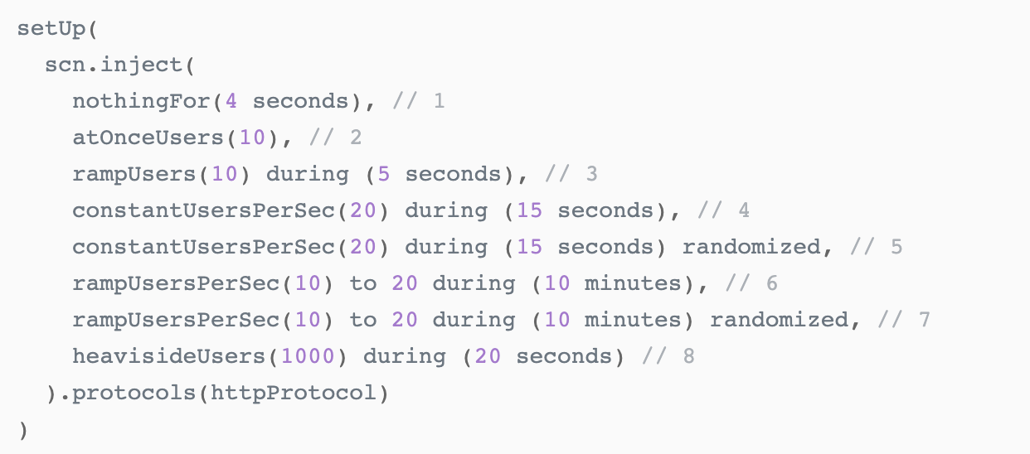
Simulation Setup Building blocks of the inject method
Open Model
Closed Model
nothingFor(duration): Pause for a given duration.
atOnceUsers(nbUsers): Injects a given number of users at once.
rampUsers(nbUsers) during(duration): Injects a given number of users distributed evenly on a time window of a given duration.
constantUsersPerSec(rate) during(duration): Injects users at a constant rate, defined in users per second, during a given duration. Users will be injected at regular intervals.
constantUsersPerSec(rate) during(duration) randomized: Injects users at a constant rate, defined in users per second, during a given duration. Users will be injected at randomized intervals.
rampUsersPerSec(rate1) to (rate2) during(duration): Injects users from starting rate to target rate, defined in users per second, during a given duration. Users will be injected at regular intervals.
rampUsersPerSec(rate1) to(rate2) during(duration) randomized: Injects users from starting rate to target rate, defined in users per second, during a given duration. Users will be injected at randomized intervals.
heavisideUsers(nbUsers) during(duration): Injects a given number of users following a smooth approximation of the heaviside step function stretched to a given duration.
constantConcurrentUsers(nbUsers) during(duration): Inject so that number of concurrent users in the system is constant
rampConcurrentUsers(fromNbUsers) to(toNbUsers) during(duration): Inject so that number of concurrent users in the system ramps linearly from a number to another
Example:
Additional information can be found here: https://gatling.io/docs/current/general/simulation_setup/

Slide 31
Adding ‘Think Time’
To simulate a real-life user “thinking” a bit before moving from one task to the next, add the following to your feature file’s Background:
* def sleep = function(ms){ java.lang.Thread.sleep(ms) }
* def pause = karate.get('__gatling.pause', sleep)
…and then add pause() to any Scenario you’d like to pause between API invocations:
* pause(5000)

Slide 32
Loading Test Data from a Feeder File
To load data from a feeder file, a few modification to your .scala file are required to identify the file to be used for supplying data to your performance tests and to reference it when creating your scenario, e.g.:
val feeder = csv(MyFeederFile.csv).circular
val create = scenario("create")
.feed(feeder)
.exec(karateFeature("classpath:performance/preauthorization.feature"))
The circular bit that is highlighted above is a “strategy,” telling Gatling to go back to the beginning of the feeder file when it cycles through to the end of your data. random can also be used here to ensure you don’t run out of data to use for each test.
You’ll also need to reference the appropriate variables from your feeder file in the Background of your feature file by using the Gatling session object, e.g.:
Background:
* set variable1 = __gatling.Variable1
* set variable2 = __gatling.Variable2
Reference: https://gatling.io/docs/current/session/feeder/
Notes:
Gatling also provides a built-in that reads from a JDBC connection.

Slide 33
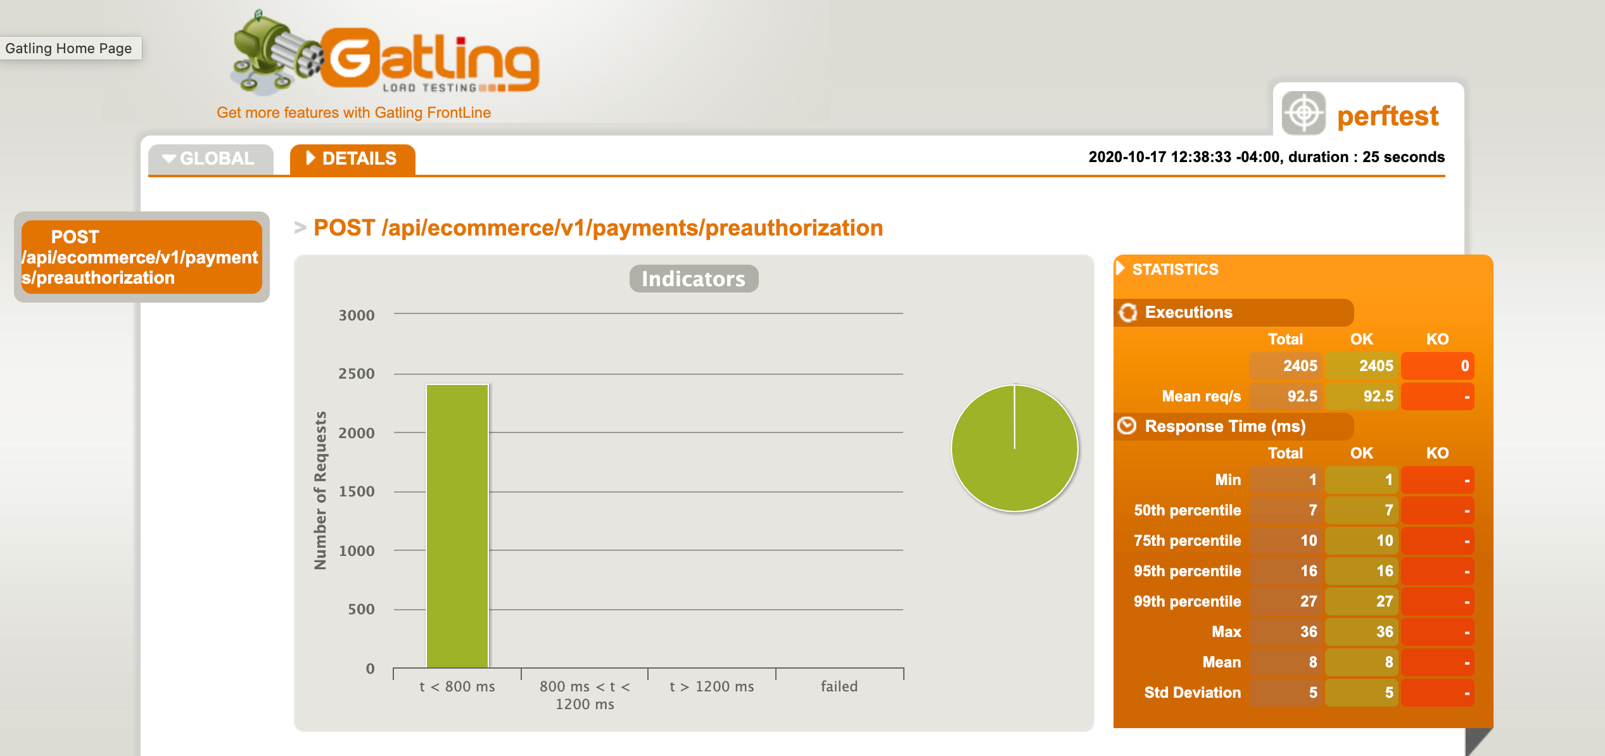
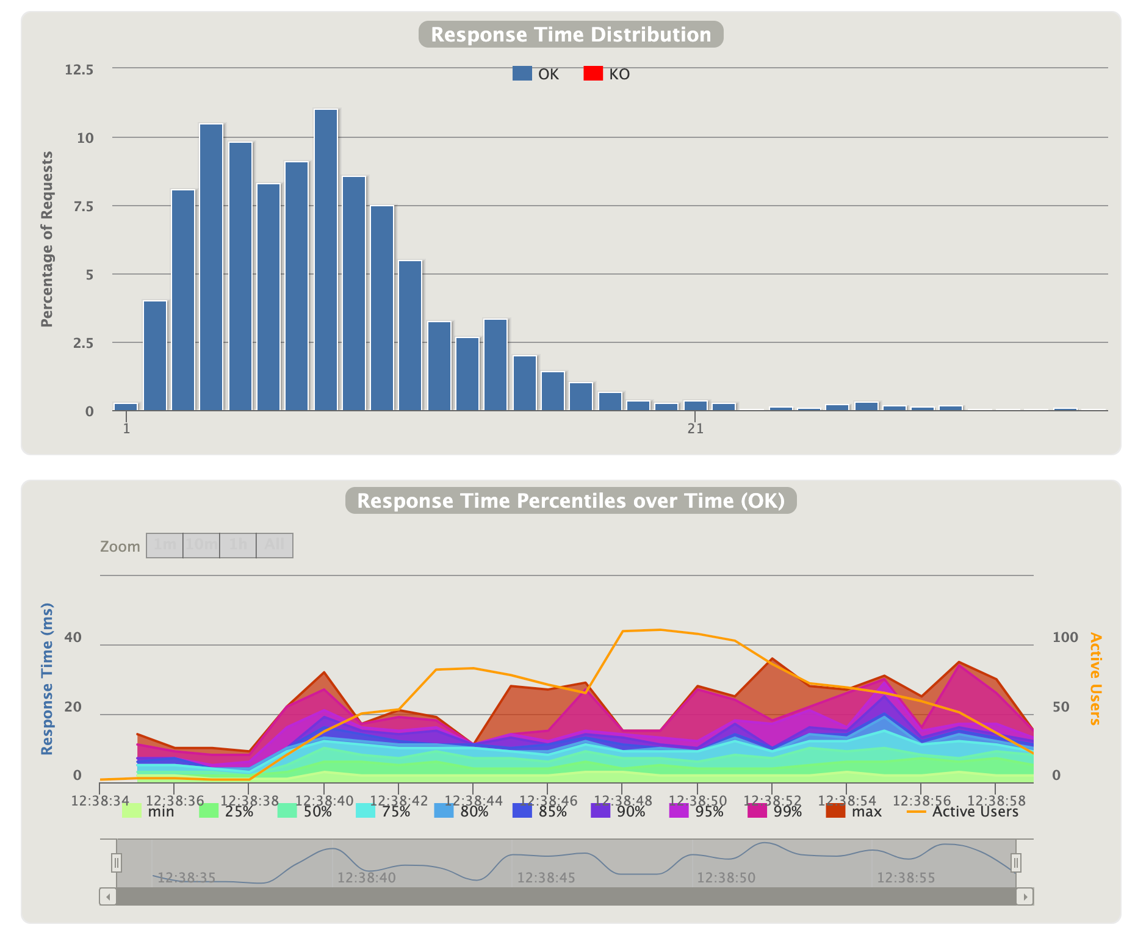
Performance Report
All performance testing results are captured in your ~/target/gatling folder

Slide 34
UI Testing with Karate Core

Slide 35

Core Features & Capabilities
Simple syntax
Parallel test execution (on a single node, cloud CI environment or Docker without needing a master node or “grid”) – works across different machines, as well
HTML reports (including video recordings of tests)
Cross-browser support
Android & iOS support (via Appium)
Powerful assertions with ‘match’ command
Environment switching
Test grouping & tagging
Support for hybrid API/UI testing
Ref: https://github.com/intuit/karate/tree/master/karate-core#capabilities

Slide 36
